Slide 1




Successfactors Dementia Friendly Initiatives: Mentality
ZonMw Memorabel project
Marjolein Thijssen MscOT, PhD candidate
Prof. dr. Maud Graff (projectleader, promotor)
Prof. dr. Ria Nijhuis-van der Sanden (promotor)
Dr. Ramon Daniels (co-project leader, co-promotor)
Dr. Wietske Kuijer (senior researcher, co-promotor)
Dr. Monique Lexis (senior-researcher)
Email: marjolein.thijssen@radboudumc.nl- linked inn: https://www.linkedin.com/in/marjolein-thijssen-a39ab19/
Mentality-website: https://mentality.space/
Notes:
Dear all, Welcome to my presentation. My name is Marjolein Thijssen and I am PhD candidate in this study about succesfactors of dementia friendly initiatives and societies. Also welcome on behalf of the whole team.
Mentality is a collaborative project that studies succcessfactors of dementiafriendly initiatives. In phase A we developed realist program theories about the outcomes of dementia friendly initiatives, using literature review. In phase B we identified realist program theories about the development and sustainment of dementia friendly initiatives, using four Dutch best practice examples of dementia friendly communities. During Phase C these theories were implemented across multiple sites for testing theories, refinement and evaluating impact in the Netherlands.

Slide 2
Content of this presentation
Dutch context for people with dementia and their carers
Outcomes of DFI according to people with dementia and their carers
Development and sustainment of DFI: what matters?
Interdisciplinary collaboration during the development and sustainment of DFI

Slide 3
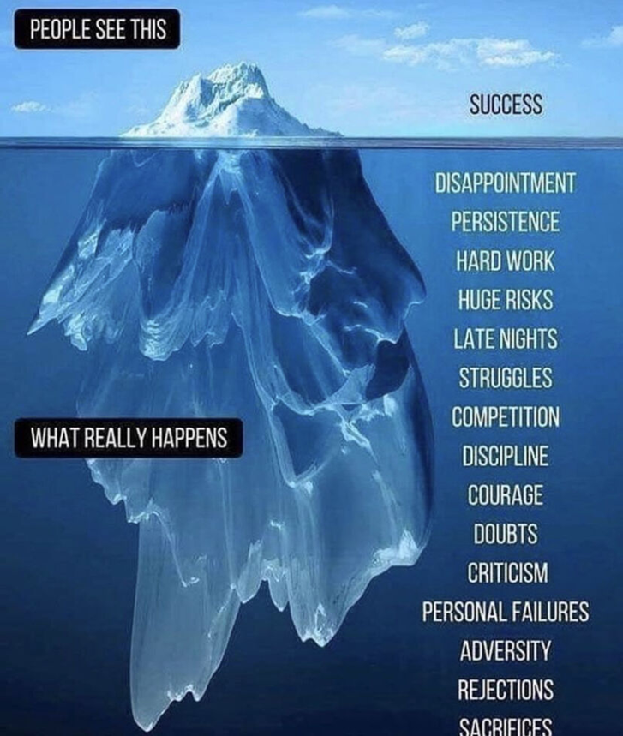




Use of the realist approach in Mentality
Mechanisms: what is hidden, matters the most
Looking for mechanisms by extracting Context-mechanisms-outcome configurations
Context
Outcomes
Phase A: Rapid realist literature review
Phase B: Multiple case study best practices NL & UK
Phase C: Realist Evaluation 4 pilot communities
Mechanisms-resource
Mechanisms-response
Basic components of a realist causal explanation
Pawson R, & Tilley N. 1997 [2003]. Realistic Evaluation. Thousand Oaks, CA: Sage Publications
Notes:
Our research consists in three parts:
In phase A we developed realist program theories about the outcomes of dementia friendly initiatives, using literature review. In phase B we identified realist program theories about the development and sustainment of dementia friendly initiatives, using four Dutch best practice examples of dementia friendly communities. During Phase C these theories were implemented across multiple sites for testing theories, refinement and evaluating impact in the Netherlands.
The realist approach, illustrated by an iceberg- is theory-driven approach Used to assess complex interventions and is Concerned with understanding the causal relation between context-mechanisms and outcomes.
Their vision on the success of complex interventions, such as dementia friendly initiatives is, what is hidden, matters the most

Slide 4
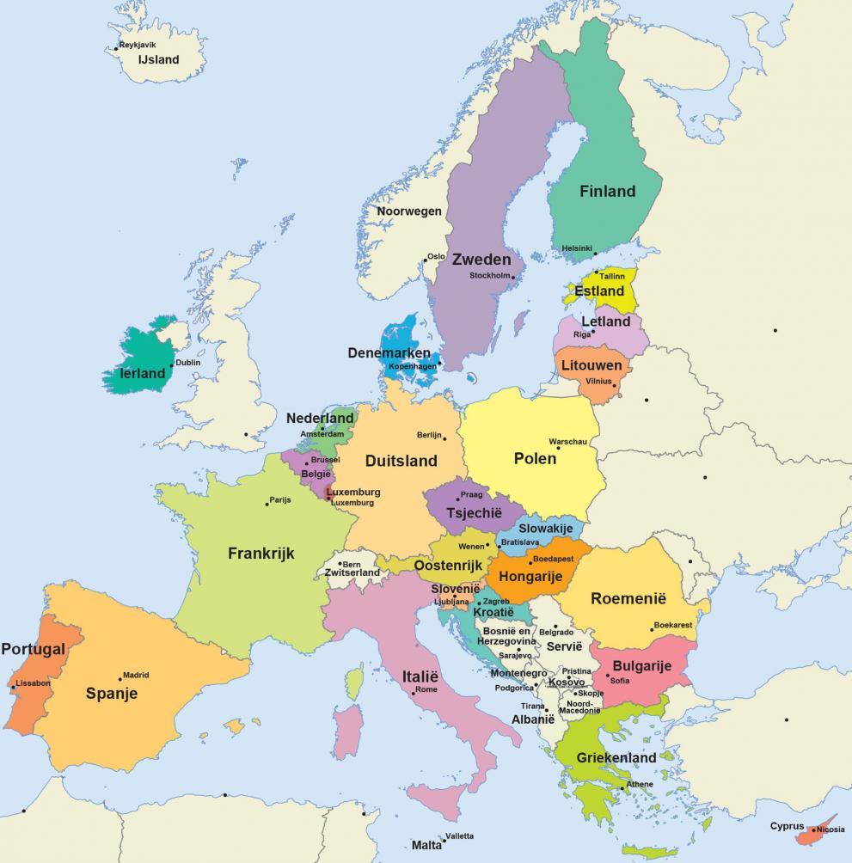
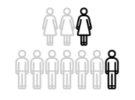
Dutch context
620.000
520.000
Prevalence of dementia in the Netherlands.
Women-men
(Source: Factsheet cijfers en feiten over dementie | Alzheimer Nederland (alzheimer-nederland.nl)
260.000
2016
2040
2050

Slide 5
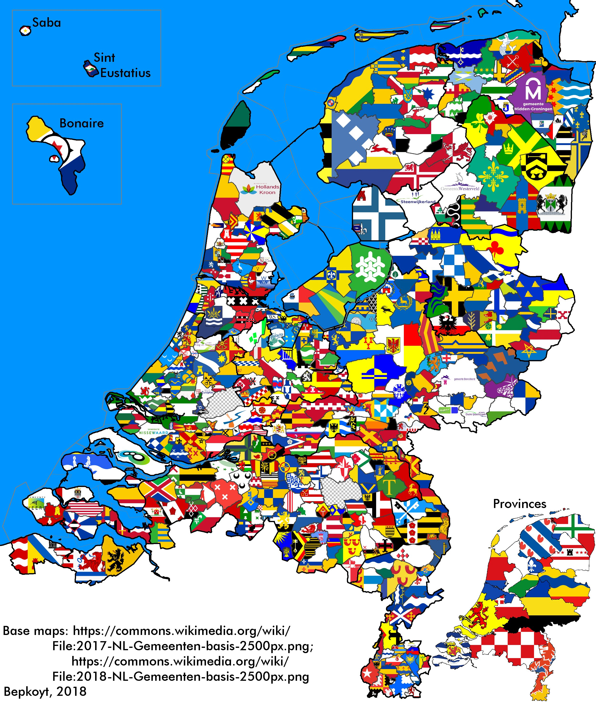



Dutch context: support for people with dementia and their carers.
Locally organized, prefarably in network based primary care per municipality or region.
Shortage of workers-human rights movement
Real focus on inclusion?
Dementia friendly initiatives in a community-> municipality.
Case manager
Home care, allied care
Notes:
Care is mosty initiated by problems or symptoms of dementia

Slide 6
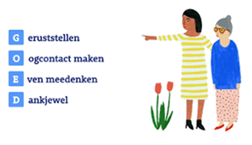
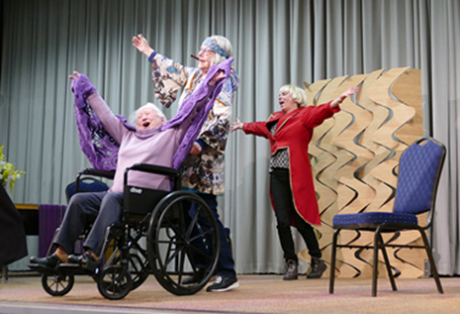
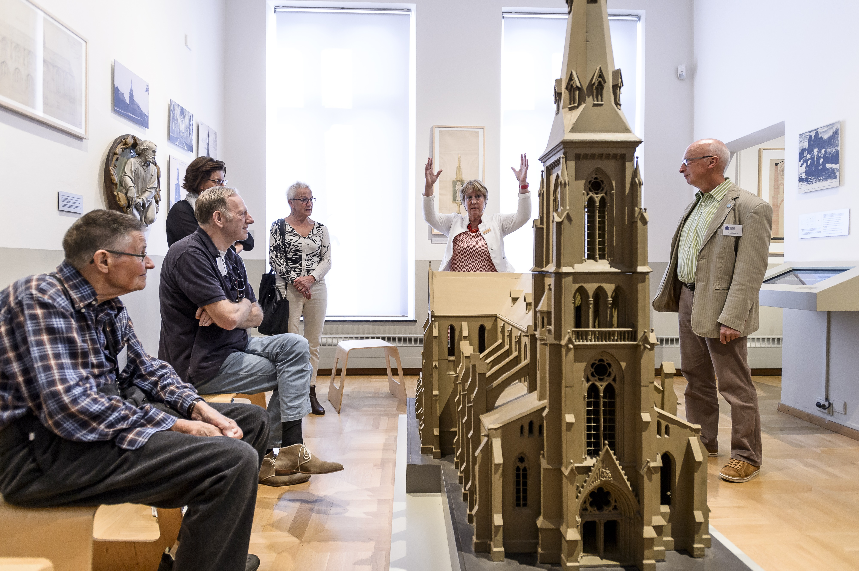
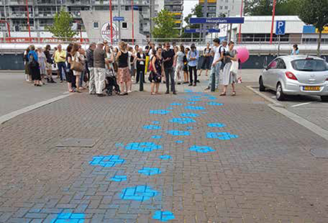
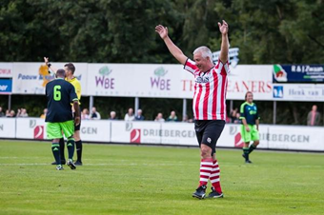

Dementia friendly initiatives in the literature
Of 7154, 22 papers included in which outcomes were obtained by empirical data from people with dementia and their carers.
Dementia specific -> Caring community
Dementia inclusive -> stimulating community
Dementia engagement & awareness -> activating community
Source: How do community based dementia friendly initiatives work for people with dementia and their caregivers, and why? A rapid realist review - PubMed (nih.gov)

Slide 7

Results review: outcomes of DFI according to people with dementia and carers
Caring community
Having contact, solving problems
Being a patient
Stimulating community
Connect, fun and stress reduction
Being a member
Activating community
Engage and initiate
Being a citizen
Source: How do community based dementia friendly initiatives work for people with dementia and their caregivers, and why? A rapid realist review - PubMed (nih.gov)

Slide 8
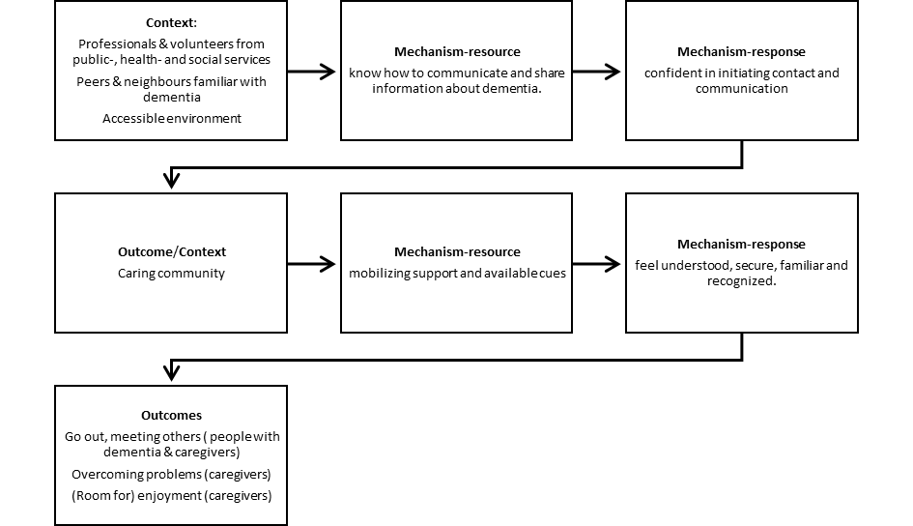
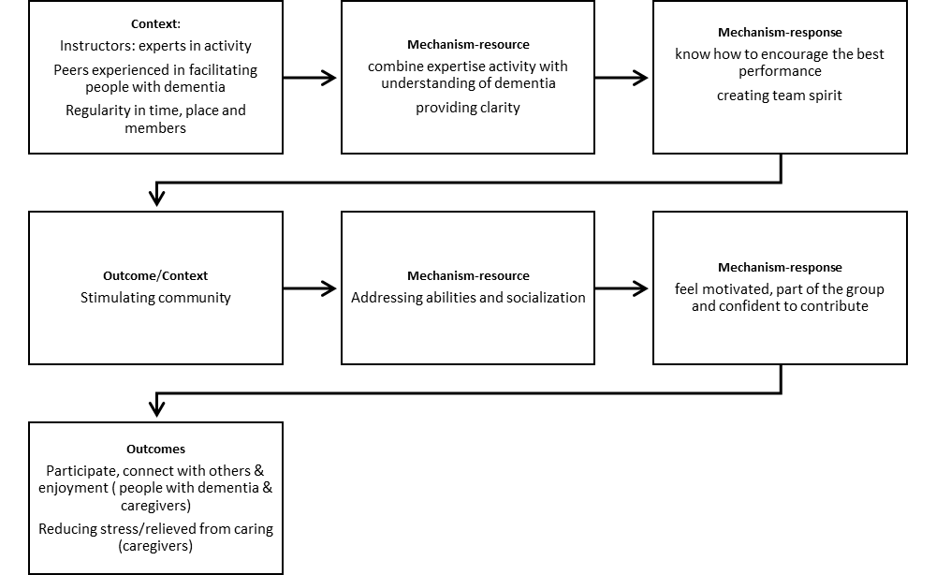
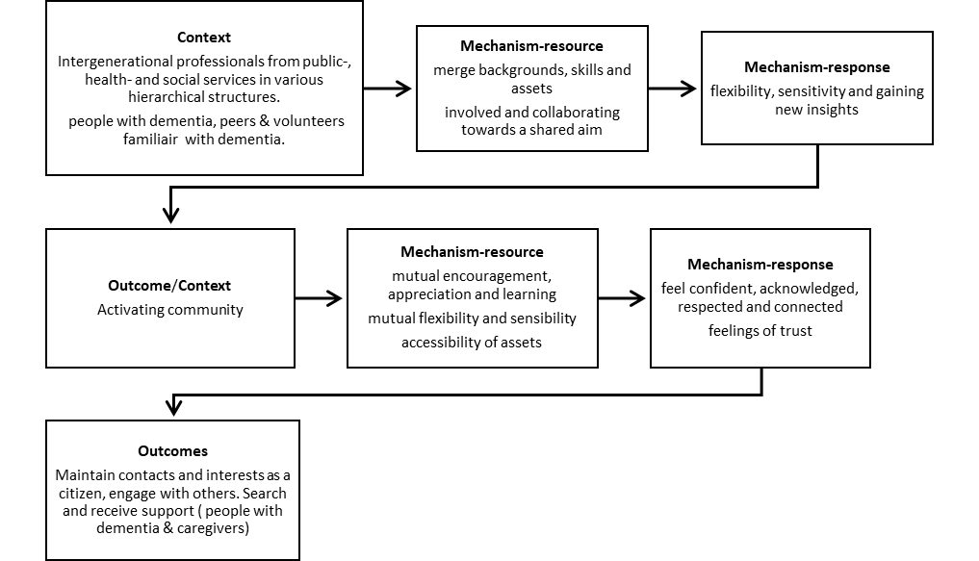



Fase A Weergave resultaten
Initiatieven vanuit bewustzijn/betrokkenheid
Dementie-specifiek initiatieven
Dementie- inclusieve initiatieven

Slide 9
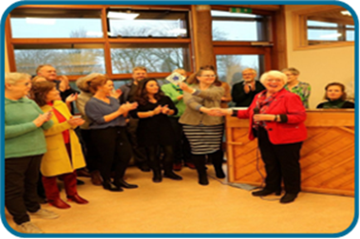
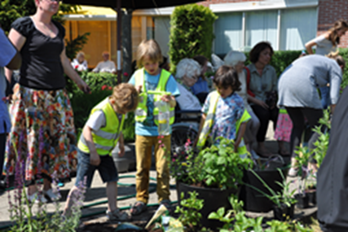

Who were collaborating in the development of dementiafriendly inititiatives in the community?
Professionals healthcare:
Home care nurses/district nurses
Elderly advisors
Volunteers:
Personal knowledge about dementia/personal relationship
Related because of interest and characteristic initiative
Related to another voluntary organisation (Alzheimer Netherlands, zonnebloem)
Policiy makers municipality
Enterpreneurs community
Allied health professionals
Shops/factories
One-man enterprises
Neighbors and community citizens
Movement coaches
Mental Healthcare collaborators
Professionals from welfare
People with dementia and caregivers
Huisarts, POH, e.a.
Wijkkrant, media, netwerk
Informeren en verwijzen

Slide 10
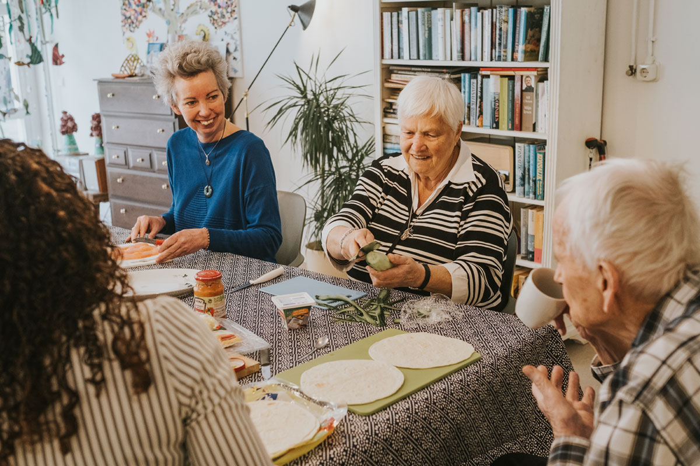

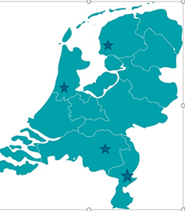

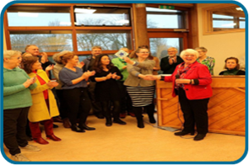



Development and sustainment of DFIs; what matters?
Multiple case study: 4 best practices with differents DFIs
Interviews, observations, documents and focusgroups
Network sampling of people who were involved.
  Professionals (46), volunteers (20),
  people with dementia (1) and carers (2)
Source: Thijssen et al (2022) What matters in development and sustainment of community dementia friendly initiatives and why? A realist multiple case study.
BMC Public Health Submitted
What matters in development and sustainment of community dementia friendly initiatives and why? A realist multiple case study | Research Square

Slide 11
Results of best practices: Development and sustainment of DFIs; what matters?
Building public support
Institutional & organizational level
Context:
Diversity in professional background of involved stakeholders
Mechanisms:
Reciprocity in interest
Sharing resources
Importance of a network
Outcomes:
Positive feeling of own input
Taking initiatives for DFIs
Interdisciplinary collaboration
Interpersonal level
Mechanisms
Positive approach:
Feelings of making a difference, connection and encouragament
Participation in DFI
Interpersonal & individual level
Source: Thijssen et al (2022) What matters in development and sustainment of community dementia friendly initiatives and why? A realist multiple case study.
BMC Public Health Submitted
What matters in development and sustainment of community dementia friendly initiatives and why? A realist multiple case study | Research Square

Slide 12
Resultaten fase B
Building public support
Institutional and organisational
Collaboration
Interpersonal
Participation in DFIs by people with dementia and carers
Interpersonal and individual

Slide 13
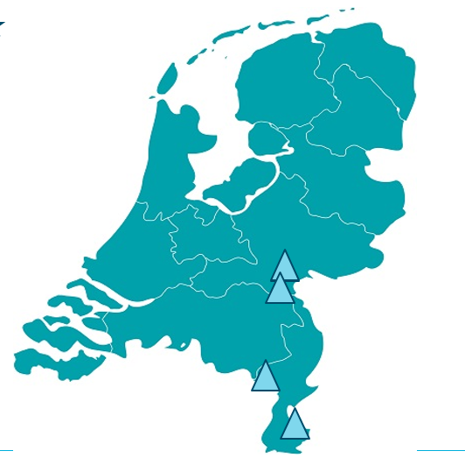


Interdisciplinary collaboration during the development and sustainment of DFI
4 pilot municipalities ambition to develop DFIs
Further develop the theory of Interdiciplinary collaboration
Communities of practice, meetings 1 per 5 weeks or 1 per 6 months (corona!)
Participants:
6 Focusgroups, informed by minutes, observations and reflections, and 2 exit interviews
 | CS 1 N |  | CS 2 W |  | CS 3 H |  | CS 4 M
 | Included | Dropped out | Included | Dropped out | Included | Dropped out | Included | Dropped out
Health- and social professionals | 5 | 0 | 3 | 0 | 10 | 2 (replaced) | 3 | 3
Volunteers/community members | 3 | 1 (not replaced) | 7 | 4 (not replaced) | 7 | 0 | 0 | 0
Entrepreneurs | 0 | 0 | 1 | 1 (not replaced) | 0 | 0 | 0 | 0
Policy officer | 1 | 0 | 1 | 0 | 1 | 1 (replaced) | 1 | 1
People with dementia and/or their caregiver | 1 | 0 | 1 | 1 (not replaced) | 0 | 0 | 0 | 0
Total participants per CoP | 9 |  | 7 |  | 18 |  | 0
Source: Thijssen et al (2022) Working together to create dementia-friendly communities. A realist evaluation

Slide 14
Results: Interdisciplinary collaboration during the development and sustainment of DFI
Mechanisms
Outcomes
Leader(ship) Groupdynamics DFI
Taking initiative,
Getting new ideas,
Motivation,
Fun,
Fullfilment
Equivalence
Acknowledgement
Feeling significant
Belonging
Activating
Responsibilty-Feeling significant
Structure
Support
3
2
Context
1
1: Municipality with an ambition to become DFI
2: Diversity in a network
3: Clarity about roles, budget and manpower
Source: Thijssen et al (2022) Working together to create dementia-friendly communities. A realist evaluation

Slide 15

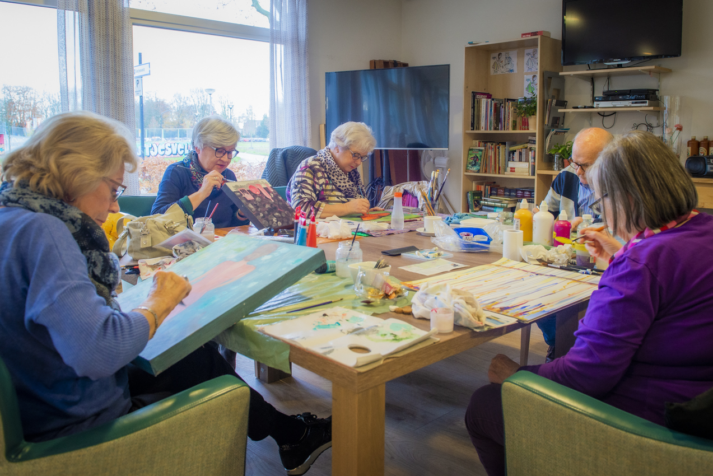
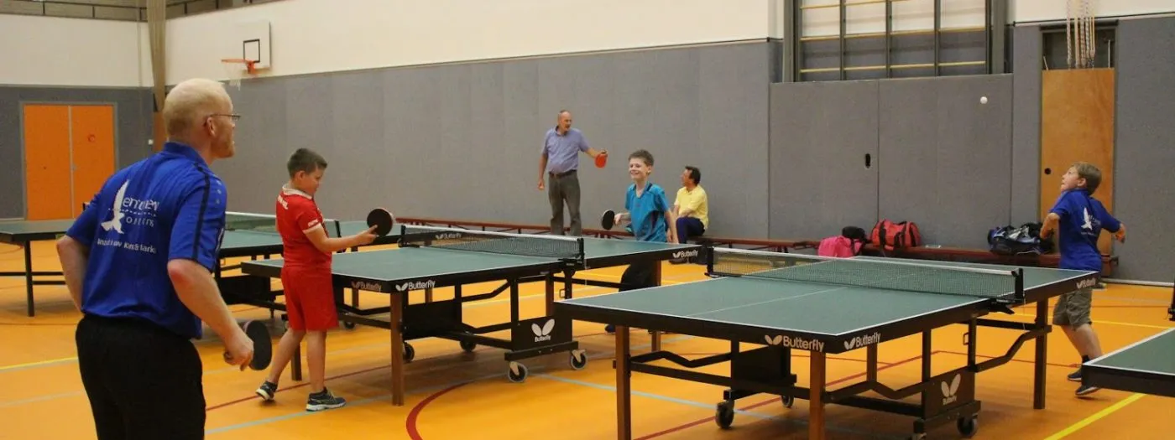
Perspectives on involvement of people with dementia and their cares

Slide 16


Thank you for your attention
Contact: Marjolein.Thijssen@radboudumc.nl
For informatie project: www.mentality.space

Slide 17
Results

Slide 18





Approach of Mentality
The succesfactors promote insights in the devlopment of dementiafriendlyness and serve as a mirror
A: Realist review outcomes of initiatives
Reflection-tool
C: Realist Evaluation;
testing & refinement theory
B: Realist multiple case study; best practices; development of initiatives
2018- 2019 Sept 2020- December 2021

